Slide 1
Forwards Induction,
Pharmaceutical Research and Risk
1
Notes:
Models for resource allocation in pharmaceutical research. Software for this purpose and two branches of relevant theory, with some quite nice, but incomplete analytical results.

Slide 2
Single Machine Scheduling
There are n jobs to be processed on a single machine. A cost c_{i} is incurred per unit of time until job i has been completed, and the service time (or processing time) for job i is s_{i}. In what order should the jobs be processed so as to minimise the total cost? (Smith, 1956).
Notes:
To introduce the idea of forwards induction we consider some examples.

Slide 3
Single Machine Scheduling Soln
An optimal policy is one which does the jobs in descending order of c_{i}/s_{i}. This follows from a simple interchange argument.
Notes:
A powerful tool for scheduling problems. Lucky Smith!

Slide 4
Gold Mining
A woman owns n gold mines and a gold-mining machine. Each day she must assign the machine to one of the mines. When the machine is assigned to mine i the probability is p_{i} that a proportion q_{i} of the gold is extracted, and with probability 1 – p_{i} the machine breaks down permanently and no gold is extracted. To what sequence of mines should the machine be assigned on successive days so as to maximise the expected amount of gold extracted before the machine breaks down? (Bellman, 1957)
Notes:
Two classic scheduling problems.

Slide 5
Search
An object is hidden in one of n boxes. P(object is found|box i containing object is searched) = q_{i}. P(object is in box i) = p_{i}, and changes by Bayes’ theorem as boxes are searched. Cost of a search of box i = c_{i}.
How should box searches be sequenced so as to minimise the expected cost of finding the object? (Bellman, 1957)

Slide 6
Optimal Policies
Gold-mining. When x_{i} is the amount of gold remaining in mine i, the mine j selected is such that p_{j}q_{j}x_{j}/(1-p_{j}) = max_{i}(p_{i}q_{i}x_{i}/(1-p_{i})).
Search. If box j is searched under an optimal policy then p_{j}q_{j}/c_{j} = max_{i}(p_{i}q_{i}/c_{i}).
Notes:
Proofs again by interchange arguments. Each priority index takes the form E(Gain)/E(Cost)

Slide 7
Discounted Jobs
There are n jobs (or research projects) to be carried out in any order, with no switching costs. The reward from completing job i at time t is V_{i}e^{-γt}. The service time for job i is σ_{i}, which has distribution function F_{i} and density function f_{i}. What policy maximises the expected total reward?
Notes:
Jobs again, now discounted and with stochastic duration, and possibly allowing switching.

Slide 8
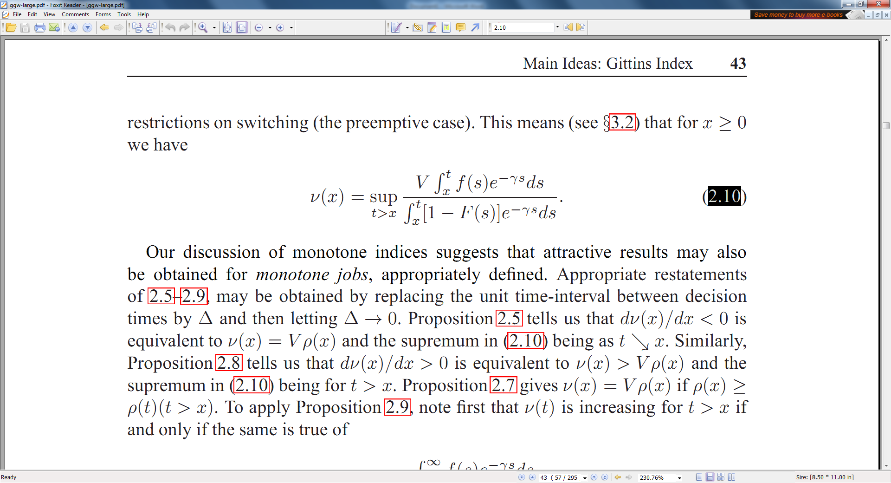
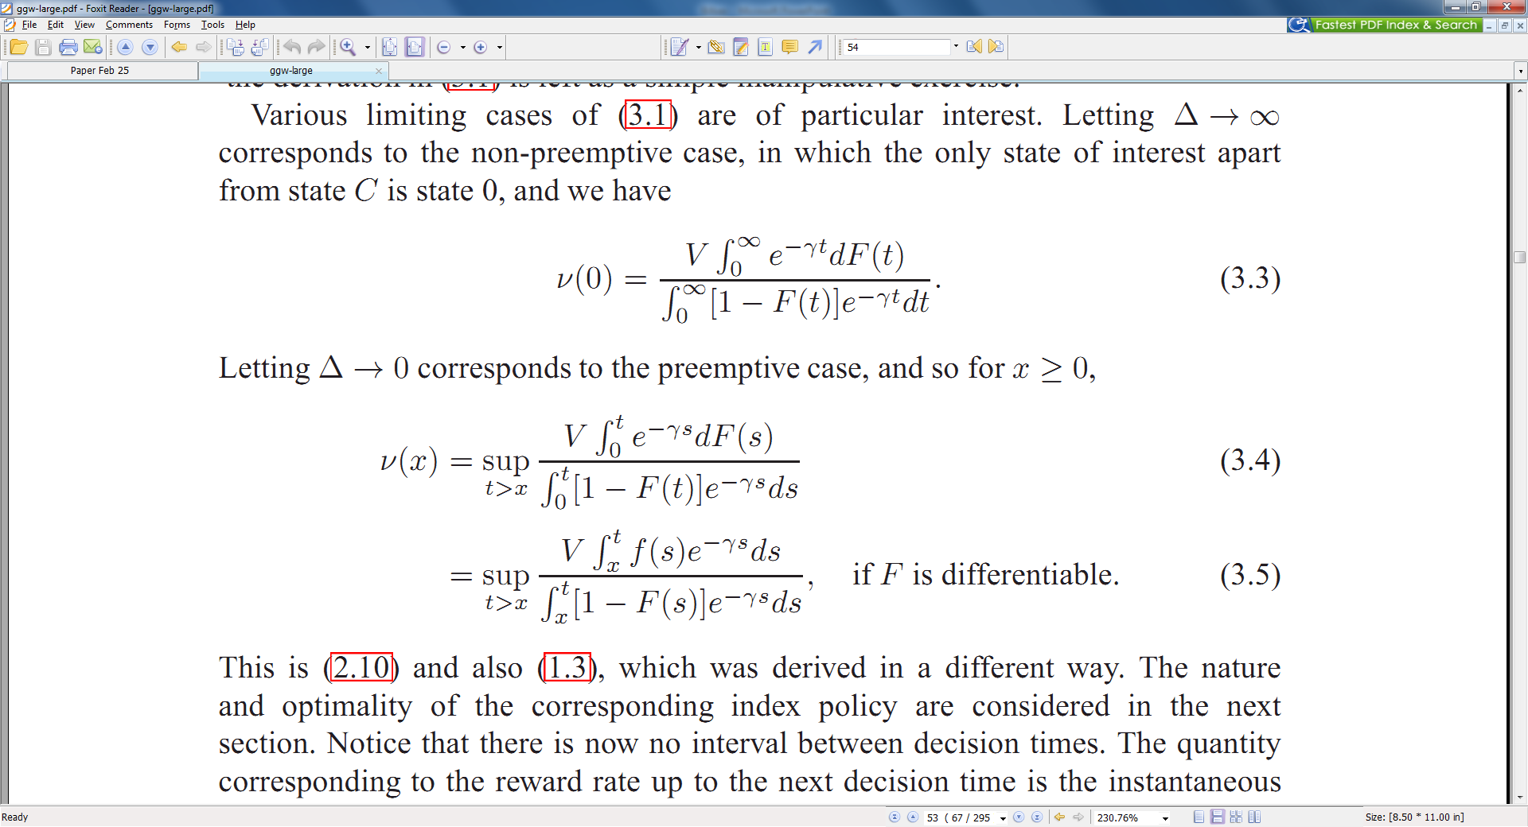
Discounted Jobs
The Preemptive case (1.3)
The Non-Preemptive case
Notes:
These are priority indices. In each case they are ratios of expected gain to expected cost.

Slide 9
Discounted Jobs
The completion rate (hazard rate) is defined as ρ(s) = f(s)/[1-F(s)]. If this is decreasing ν(x) reduces to V(ρ(x)). In general using V(ρ(x)) as a priority index gives the myopic policy which maximises the expected return during the next infinitesimal time interval.

Slide 10
Forwards Induction for a Markov Decision Process (Puterman 2005)
The next decision is always the one that maximises the expected reward rate up to an optimally selected stopping time. So this is a modified myopic decision rule. It is optimal for resource allocation problems which can be formulated as Multi-armed Bandit Problems .
Notes:
Say what an MABP is. Mention discounting. Explain Forwards Induction. Two broad dimensions of optimality. Equivalent to an index policy for a MABP.

Slide 11

Notes:
Acknowledge Kevin Glazebrook, Richard Weber, David Jones, Peter Nash, Frank Kelly, Peter Whittle, Michael Katehakis and many others. 750 citations.

Slide 12
OPRRA Software: Optimising Pharmaceutical
Research Resource Allocation
John Gittins, Bert Chen, Jiun-yu Yu,
Charis Charalambous, Shuo Qu
and Anne-Marie Oreskovich
Notes:
21st century acknowlegements! 5 recent research students as listed

Slide 13
PURPOSE OF OPRRA
OPRRA models the relationships between profitability and effort allocations to the successive early stages of a pharmaceutical research project, to assist management in finding allocations which are both feasible and profitable.
OPRRA can be used to model individual projects, and to investigate the consequences of different allocations across a portfolio of projects.

Slide 14
Inputs for each Project
Values and Costs.
Bench-mark Success Probabilities and Durations for Discovery Stages and Clinical Trials Phases.
Bench-mark Allocations of Scientists for the Discovery (ie Preclinical) Stages.
Judgements on the relationship between Rate of Progress and Number of Scientists allocated.
Judgements on the extent and likely impact of Competitive Developments in other Companies.
These may be entered as probability distributions, allowing for uncertainty, which may be very high.
Notes:
‘Discovery’ refers to the discovery of new candidate drugs. The general idea is to use the available data and judgements to analyse evaluate and compare different possible allocation strategies.

Slide 15
Value of OPRRA to Research Managers
It is difficult to achieve the right balance between the urgency of making progress and the potential loss of efficiency with too large a team size on a project.
Competition obviously has an influence on how this balance should be struck, but it is not so obvious what this influence is. It could either lead to allocating more or fewer scientists to a project.
OPRRA analyses these factors. Frequently this results in a very large increase in profitability.

Slide 16
Value of OPRRA to Research Managers, continued…
For a portfolio of projects it allows allocation plans to be evaluated in terms of
  profitability,
  riskiness,
  and effective use of available resources.
This is done by fairly sophisticated simulation and sensitivity analysis, with guidance from the profit maximisation calculations for individual projects.

Slide 17
Finding a Candidate Drug
The process of discovering a CD is modelled as five largely consecutive stages.
Target Identification.
Looking for a Lead Series.
Looking for a backup LS.
Looking for a first CD in a LS (or optimising the LS).
Looking for a backup CD in a LS which has already provided one or more CDs.
Notes:
Explain the terminology

Slide 18
Profitability Index (PI)
(Brealey, Myers and Marcus, 2009)
OPRRA has a forwards induction algorithm which seeks to select CDs so as to maximise the profitability of a project as measured by
Profitability Index = E(Reward)/E(Cost).
Notes:
Not ENPV as it is for an MABP. We are moving on from the MABP assumption of a constant fixed total available resource rate. We are now in the more realistic regime of implicitly limited but flexible resource rate availability, non-linear resource effectiveness functions, and explicit costs.

Slide 19
CD Selection FI Algorithm
Decide a reference PI PI(ref).
At the next decision point compare PI(new CD), PI(new LS) and PI(ref).
If PI(CD) is largest take a further CD from the ‘youngest’ current CD and go to Step 2.
If PI(LS) is largest optimise a further LS and if
(a) this produces a CD then take it and go to Step 2, or if (b) it produces no CD then go to Step 2.
If PI(ref) is largest then stop

Slide 20
A Simplified Candidate Drug Selection Problem
In this simplified problem, we allow CDs to be selected from at most one LS. We also assume that whenever stage 4 is carried out stage 3 is carried out in parallel.
The forwards induction algorithm proceeds as before except that after the first LS to be successfully optimised there is no longer the option to optimise a new LS.
FI is optimal for the simplified problem.
Notes:
The simplified problem has a neat algorithmic solution, which is essentially FI

Slide 21
Problem 1
For j = 1, 2, . . . , let r_{j} be real numbers and c_{j} be positive real numbers and let q_{j} = r_{j}/c_{j}, where q_{j} ≥ q_{j+1} when j > 1, and q_{j} → q < 0 as j → ∞. Define R(k) =∑_{{1≤j≤k}}r_{j} , C(k) = ∑_{{1≤j≤k}}c_{j} ,
Q(k) = R(k)/C(k) , Q = max_{k} Q(k).
The problem is either to show that Q ≤ 0, or to find k such that Q(k) = Q.
Notes:
Non-trivial because q1 < q2 is possible. Rs and Cs for the moment are just real numbers. In our applications they are rewards and costs.

Slide 22
Algorithm 1
Compute Q(k), k = 1,2,... .
Stop when q_{k} ≥ Q(k) > q_{k+1}, in which case Q(k) = Q, or when Q(j) ≤ 0, 1 ≤ j ≤ k, and q_{k+1} ≤ 0, in which case Q ≤ 0.

Slide 23
Problems 1I and 1W
Problem 1I. For x ∈ the finite index set I, which includes 1, let r_{x} be a real number, c_{x} be a positive real number, and let q_{x} = r_{x}/c_{x}.
Let S denote a subset of I, R(S) = ∑_{{x ∈ S}}r_{x}, C(S) = ∑_{{x ∈ S}}c_{x}, Q(S) = R(S)/C(S), and Q = max_{{S∈ U}} Q(S),
where U = {S ⊂ I, 1 ∈ S}. The problem is to find S∈ U such that Q(S) = Q.
Problem 1W. This is the same as Problem 1I except that the class of index subsets U is replaced by a sub-class W ⊂ U.

Slide 24
Problem 1V
V denotes the class of index subsets of the form {x, q_{x} > ξ} + 1 for some ξ.
Lemma. For any S ∈ U ∃ S′ ∈ V , with Q(S′) ≥ Q(S).
Problem 1V is the same as Problem 1W with the restriction that W ⊃ V.
Notes:
The lemma means that with suitable relabelling of index values we can use Algorithm 1.

Slide 25
Solution of Problems 1I and 1V
Problems 1I and 1V may be transformed into problems of the form of Problem 1, as follows. For each triple (r_{x}, c_{x}, q_{x}) change the index to one of the first |I| integers, leaving the values of the triple unchanged. Choose the new index values so that r₁, c₁ and q₁ are unchanged and q_{i} ≥ q_{i+1}, i > 1. Let q_{i} be large and negative for i > |I|.

Slide 26
Problem 2
For (i, j = 1, 2, . . . ), let r_{ij} be real numbers, c_{ij} be positive real numbers, and q_{ij} = r_{ij}/c_{ij}, where q_{i1} > q_{i+1,1} for i > 1 , q_{ij} > q_{ij+1} for (i, j) ≠ (1, 1), q_{i1} → q < 0 as i → ∞, and q_{ij} → q_{i} < 0 as j → ∞∀ i.
Define R_{i}(k) = ∑_{{1≤j≤k}}r_{ij} , C_{i}(k) = ∑_{{1≤j≤k}}c_{ij} , R(k₁, k₂, . . . , k_{n}) = ∑_{{1≤i≤n}} R_{i}(k_{i}), C(k₁, k₂, . . . , k_{n}) = ∑_{{1≤i≤n}} C_{i}(k_{i}),
Q(k₁, k₂, . . . , k_{n}) = R(k₁, k₂, . . . , k_{n})/C(k₁, k₂, . . . , k_{n}), Q = max_{A}Q(k₁, k₂, . . . , k_{n}), where A = {n > 0; k_{i} > 0, i = 1, 2, . . . , n}.
The problem is either to show that Q ≤ 0 or to find ν, κ₁, κ₂, . . . , κ_{ν}, such that Q = Q(κ₁, κ₂, . . . , κ_{ν}).
Notes:
Problem 2 fits the SCDS. k_{i} is the number of CDs selected if the first (and only) LS to produce CDs is the i’th.

Slide 27
Solution of SCDS
SCDS takes the form of Problem 2 with PI(ref) = Q (k_{i} is the number of CDs selected if the first (and only) LS to produce CDs is the i’th).
Problem 2 is an example of Problem 1V, with the index pair 11 in place of 1.
Problem 1V reduces to Problem 1, and may therefore be solved by Algorithm 1.
Notes:
Our first solution of a simplified problem.

Slide 28
Capital Project Valuation taking account of Risk
First Candidate:
Expectation and Variance of Net Present Value, discounting at the relevant Weighted Average Cost of Capital.
These measures, and WACC itself, are all measures of risk. However none addresses the key issue of the possibility of a very bad outcome.
Notes:
Second theoretical excursion. WACC is the relevant interest rate. It is an indirect measure of risk expressed by the financial markets. This ‘key issue’ is arguably what we really mean by risk; certainly it is an important component.

Slide 29
Two Candidates for doing this
Utilities
These in principle take account of the decision-maker’s attitude to risk, but have no in-built rules for dealing with different cash flows.
Value at Risk
The Value-at-Risk (VaR) is defined as a sum of money such that the probability of losing more than that amount takes some specified value. It thus does focus on bad outcomes, as required. However it focuses on a particular point in time, such as the endpoint of a project, as well as on a specific probability.
Notes:
Utilities can cope with arbitrary expressions of preference, but there remains the task of assigning values to outcomes.

Slide 30
Two ways of improving on VaR
Consider the maximum indebtedness reached by the aggregate cash flow, rather than simply the NPV at the end of the project. Call this maximum the cash flow exposure, CFE.
As above, but now add to the aggregate cash flow at each stage the expected value of future cash flows, and consider the maximum indebtedness on this basis, taking into account future prospects. Call this maximum the prospective cash flow exposure, PCFE.
The distributions of CFE and PCFE, and in particular their expectations, are the Gittins – Oreskovich (GO) measures of risk.
Notes:
These measures can be calculated, generally using Monte-Carlo methods. OPRRA does so for single projects.

Slide 31
Properties of CFE and PCFE
Theorem 1. With discount rate γ = 0, (i) CFE ≥ - NPV, (ii) PCFE ≥ -NPV.
These results are immediate consequences of the fact that NPV = NRV(T) = ENPV(T). Here T = Completion time of project, NRV(t) = Aggregate net retrospective value at time t , and ENPV(t) = Expected net present value at time t, conditional on what happens up to time t.
Notes:
Note definitions

Slide 32
Uncertainty Risk
The inequality PCFE ≥ -NPV holds with equality in the case of a deterministic sequence of costs and rewards, in which case NPV takes a unique predictable value.
Thus EPCFE + ENPV, with γ = 0, is a measure of the risk associated with uncertainty. Another such measure is Var(NPV).
Notes:
In the deterministic case the prospective maximum indebtedness is the same at all time points and equal to –NPV.

Slide 33
A Simple Example
Project with two time points. Time 0, project starts. Time 1, project finishes. γ = 0, Var(NPV) = 1, ENPV = 0.
PCFE = - min[ENPV(0), ENPV(1)]
= - min[ENPV, NPV] = max[0, - NPV]. Write -NPV = X and suppose P(X = m) = P(X = - m) = p, P(X = 0) = 1 – 2p, where m > 0. Thus EX = 0, VarX = 2pm² = 1, and EPCFE = pm = 1/2m, which takes all values in the interval (0, 0.5] as m varies between ∞ and 1.
Notes:
Explain why PCFE is as stated. We can see that it measures something different from Var(NPV)

Slide 34
Theorem 2
For a random variable X∈R the maximum value of E(max[0,X]), subject to the constraints EX = 0 and VarX = 1, is 0.5, and occurs when P(X = 1) = P(X = - 1) = 0.5.
Notes:
A neat, trivial, analytical result. Hopefully other more general results relating Var(NPV) and EPCFE will follow.

Slide 35
References
Qu, S., and Gittins, J.C. (2011), ‘A forwards induction approach to candidate drug selection’, Advances in Applied Probability, 43, pp 649 - 665.
Oreskovich, A. (2014), ‘New Measures of Risk in Pharmaceutical Research’, DPhil thesis, Oxford University
35
Notes:
Models for resource allocation in pharmaceutical research. Two branches of relevant theory, with some nice, but incomplete analytical results.

Slide 37
INPUTS REQUIRED
Values and Costs.
Bench-mark Success Probabilities and Durations for Discovery Stages and Clinical Trials Phases.
Bench-mark Allocations of Scientists for the Discovery (ie Preclinical) Stages.
Judgements on the relationship between Rate of Progress and Number of Scientists allocated.
Judgements on the extent and likely impact of Competitive Developments in other Companies.
These may be entered as probability distributions, allowing for uncertainty, which may be very high.

Slide 38
VALUES AND COSTS
Weighted average cost of capital for the company, preferably in inflation-free terms.
Expected net present value of a new drug available and approved for marketing.
Average cost of employing a senior scientist for a year, including all overheads and the cost of support staff.
Expected costs of clinical trials phases I, II and III.

Slide 39
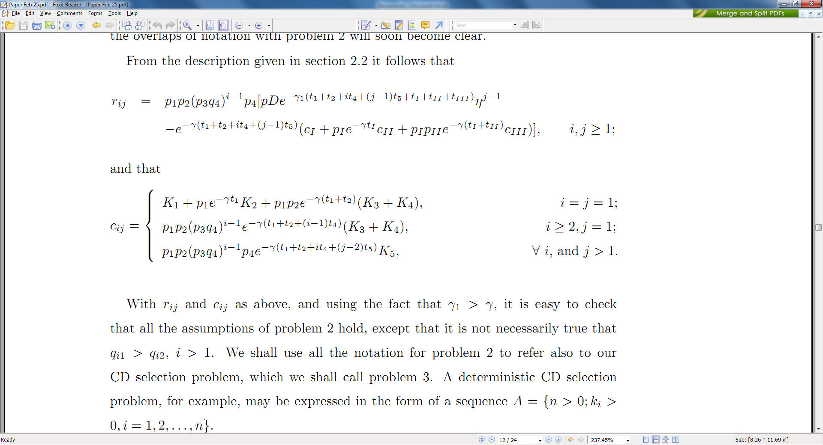
Problem 3

Slide 40
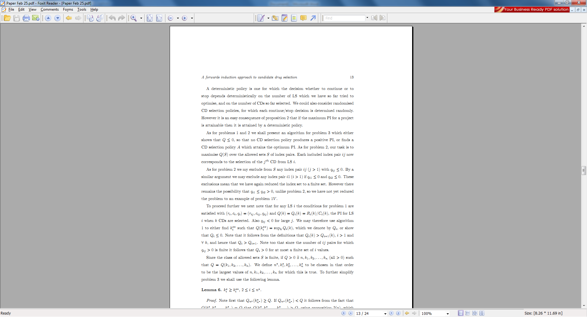
Solving Problem 3

Slide 41
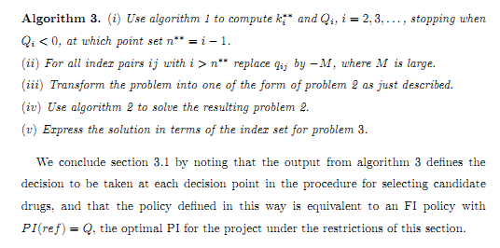
Algorithm 3

Slide 42
OPRRA Software: Optimising Pharmaceutical
Research Resource Allocation
John Gittins, Shuo Qu
and Anne-Marie Oreskovich
July 13, 2010
Notes:
Being a pharmaceutical company requires great patience and enormous capital. It typically takes 12 to 15 years to successfully complete the research and development (R&D) process of a new drug, with probability of success less than 20%, while the combined cost of R&D and market introduction for a significant product today exceeds £ 700 million. As a result, bringing research projects to an early successful conclusion becomes an important competitive advantage.

Slide 43
OVER THE PAST 10 YEARS, PHARMA HAS INVESTED 70% MORE ON R&D, WHILST NME OUTPUT HAS DECREASED BY 30%
* The development time data point for 2008 includes data from 2006 and 2007 only
SOURCE: CMR INTERNATIONAL PERFORMANCE METRICS PROGRAM © THOMSON REUTERS & IMS HEALTH
Notes:
Chapter 1
Figure 1.1
Overview

Slide 44
OUTLINE
INTRODUCTION
  Purpose of OPRRA
  Value of OPRRA to Research Managers
  Inputs Required
  Outputs
THE STRUCTURE OF PRECLINICAL PHARMACEUTICAL RESEARCH PROJECTS
MATHEMATICAL MODELLING
  Plans for Further Development
USING OPRRA
  Example

Slide 45
PURPOSE OF OPRRA
OPRRA models the relationships between profitability and effort allocations to the successive early stages of a pharmaceutical research project, to assist management in finding allocations which are both feasible and profitable.
OPRRA can be used to model individual projects, and to investigate the consequences of different allocations across a portfolio of projects.

Slide 46
Value of OPRRA to Research Managers
It is difficult to achieve the right balance between the urgency of making progress and the potential loss of efficiency with too large a team size on a project.
Competition obviously has an influence on how this balance should be struck, but it is not so obvious what this influence is. It could either lead to allocating more or fewer scientists to a project.
OPRRA analyses these factors in a uniquely effective way, often leading to a very large increase in profitability.

Slide 47
Value of OPRRA to Research Managers, continued…
For a portfolio of projects it allows allocation plans to be evaluated in terms of
  profitability,
  riskiness,
  and effective use of available resources.
This is done by fairly sophisticated simulation and sensitivity analysis, with guidance from the profit maximisation calculations for individual projects.

Slide 48
INPUTS REQUIRED
Values and Costs.
Bench-mark Success Probabilities and Durations for Discovery Stages and Clinical Trials Phases.
Bench-mark Allocations of Scientists for the Discovery (ie Preclinical) Stages.
Judgements on the relationship between Rate of Progress and Number of Scientists allocated.
Judgements on the extent and likely impact of Competitive Developments in other Companies.
These may be entered as probability distributions, allowing for uncertainty, which may be very high.

Slide 49
VALUES AND COSTS
Weighted average cost of capital for the company, preferably in inflation-free terms.
Expected net present value of a new drug available and approved for marketing.
Average cost of employing a senior scientist for a year, including all overheads and the cost of support staff.
Expected costs of clinical trials phases I, II and III.

Slide 50
Success Probabilities and Durations for Discovery Stages and Clinical Trials Phases
Industry-wide data are available from CMR International. Hopefully most companies also keep records of experience with their own research.
The estimates and error bounds needed by OPRRA are actually judgements tailored to the particular project. No actual data is therefore strictly essential, though any relevant data is likely to improve the reliability of the judgements.

Slide 51
Allocations of Scientists for the Discovery Stages
As initial inputs, these are part of the project specification, and are also decision variables
OPRRA does not take explicit account of different types of scientists, looking only at the total resource rate allocated to a project at each stage
This may be measured as the total cash expenditure rate, or alternatively as the number of senior scientists allocated, assuming these to be equipped with normal levels of support staff, lab space, and other necessary resources

Slide 52
Rate of Progress and Number of Scientists Allocated
The default assumption is that the rate of progress is proportional to the number of scientists allocated.
OPRRA allows for the possibility that team sizes above some level may be relatively inefficient (for example, a less than 50% reduction in the time to complete a stage if the team size is doubled).

Slide 53
Outputs
Profitability measures for projects, portfolios of projects, and components of projects, for given allocation levels.
Profitability measures for individual projects optimised with respect to allocation levels.
Sensitivity of profitability measures to allocations, and to uncertainties in model parameters and project outcomes.

Slide 54
Outputs, continued…
Probability distributions of cost, reward, and profitability index.*
Projections of probability distributions of future effort requirements.*
*Both of these are for projects and portfolios of projects, for given allocation plans, and with the option of allowing for uncertainties in the model parameters.

Slide 55
The Stages of a Pre-Clinical
Research Project and their
Probabilities of Success
Before screening, p₁
Identifying the first lead series, p₂
Optimising a LS to find the first candidate drug, p₄
Looking for backup CDs, p₅ = 1.0

Slide 56
Decision Variables
1st DC from 1st LS, p4
Stage 5, k1 backups
O
p1
p2
q1
q2
Failed, q4
X
X
X
Numbers of scientists allocated to each stage,
u₁, u₂, u₄, u₅ (eg 4, 10, 15, 15)
Number of backup candidate drugs (in 5th stage),
k₁ (eg 3)
Notes:
At the end of stage 2, if the first lead series is found, we have to decide whether to find more lead series as insurance or buffer. If no, we will proceed to stage 3 directly to find the first development compound. If this lead series optimisation attempt is unfortunately a failure, the project will be terminated without any financial return. If we decide to look for more lead series, i.e., m > 1, a number of scientists should be allocated to repeat stage 2 as stage 3 is in progress. The number of such repetitions should be optimised so as to maximise the profitability and probability of success of the research project.
( When more than one lead series are required, scientists are to be divided into two teams; the majority of them focus on stage 3, the optimisation process for development compound, while the minority repeat stage 2 to find additional ”insurance” lead series. Two tasks are carries out simultaneously.)

Slide 57
More Decision Variables
s : desired number of sampled LSs (eg 2) .
n : maximum number of different LSs to be investigated, with the aim of finding CDs in s of them, s ≦ n. (eg 6)
Numbers of scientists to be allocated in each stage, (u₁, u₂, u₃, u₄, u₅) = u
Numbers of backup candidate drugs (in stage 5), (k_{i} , i = 1,…, s) = k

Slide 58
Effectiveness Function and Bounds on Allocations
For stage i (= 1,2,…5):
no more scientists than cap_{i} can be allocated;
a minimum value is input for the stage duration, which is ensured by imposing a second cap on the effort rate allocation;
the effectiveness when u senior scientists are allocated is e_{i}(u); this is fitted as follows (dropping the subscript i).
Notes:
Time needed to complete a particular stage of a research project is not necessarily inversely proportional to the number of scientists involved in this stage. As the team-size gets larger beyond certain point, the difficulties of communication and coordination will deteriorate the effectiveness of the team. The measure of the effectiveness of a team is thus introduced.

Slide 59
Effectiveness Function
e(u) : effectiveness of a team of u scientists
e(u)/u : relative efficiency of a team of u scientists
u_{f} : maximum team size for full efficiency (eg 14)
trieff = e(3u_{f} )/3u_{f} (eg 0.85)
quinteff = e(5u_{f} )/5u_{f} (eg 0.68)
Cubic interpolation fits e(u) between the values for u_{f} , 3u_{f} , and 5u_{f} .
Notes:
Time needed to complete a particular stage of a research project is not necessarily inversely proportional to the number of scientists involved in this stage. As the team-size gets larger beyond certain point, the difficulties of communication and coordination will deteriorate the effectiveness of the team. The measure of the effectiveness of a team is thus introduced.

Slide 60
Plot of Effectiveness Function
Effectiveness Function
70
60
50
40
e(u)
30
20
tripeff = 0.90, quinteff = 0.76
tripeff = 0.85, quinteff = 0.68
10
tripeff = 0.80, quinteff = 0.60
tripeff = 0.75, quinteff = 0.52
0
0
10
20
30
40
50
60
70
80
u

Slide 61
Stage Effort Needs and Durations
X_{i} = scientist-years needed for stage i ,
i = 1, 2, 3, 4, 5
ρ = X₃/X₂ (< 1, eg 0.9)
t_{i} = X_{i}/e(u_{i}) = time needed for stage i ,
i = 1, 2, 3, 4, 5
Notes:
The PI ranks projects according to the expected net present value generated per pound of expenditure. The IRR of a project may be regarded as the rate of growth of capital within the project. The goal is to look for optimal allocations of aforementioned decision variables that maximise the project’s PI and IRR respectively. This can be done by iterative Newton-Raphson procedure. Note that PI and IRR usually do not produce the same optimal allocations.
The optimisation calculation programme is written in FORTRAN 90, and the part for PI is almost completed. I will focus on IRR criterion next.

Slide 62
Clinical Trials, their Costs, and Probabilities of Success
These also take place in a sequence of stages, usually referred to as phases. We need estimates for costs and success probabilities, but do not seek to influence decisions on resource allocation.
Phase I trials are to assess the body’s response to a CD, and to establish a safe dosage range, c_{I}, p_{I}.
Phase II trials involve patients with the condition to be treated; the main aim is to establish a dose level that achieves a suitable compromise between efficiency and any adverse side effects, c_{II}, p_{II}.
Phase III trials involve large numbers of patients, typically in randomised double-blind trials, c_{III}, p_{III}.
62

Slide 63
The Probability of Clinical Success and its Structure, continued…
p_{I} = P ( I ) = P (Phase I trials are completed successfully)
p_{II} = P (Phase II trials are completed successfully | I)
p_{III} = P (Phase III trials are completed successfully
| II)
p_{I} p_{II} p_{III} = p_{a}p_{b}p_{c} = P (Phase I, II and III trials are all completed successfully) (eg 0.1)

Slide 64
Values and Costs
V = expected value net of all development costs of a CD if it were to be available now as a marketable drug (eg £1000m).
α = cost of employing a senior scientist for a year, including all attributable overhead costs and costs of support staff (eg £0.3m).

Slide 65
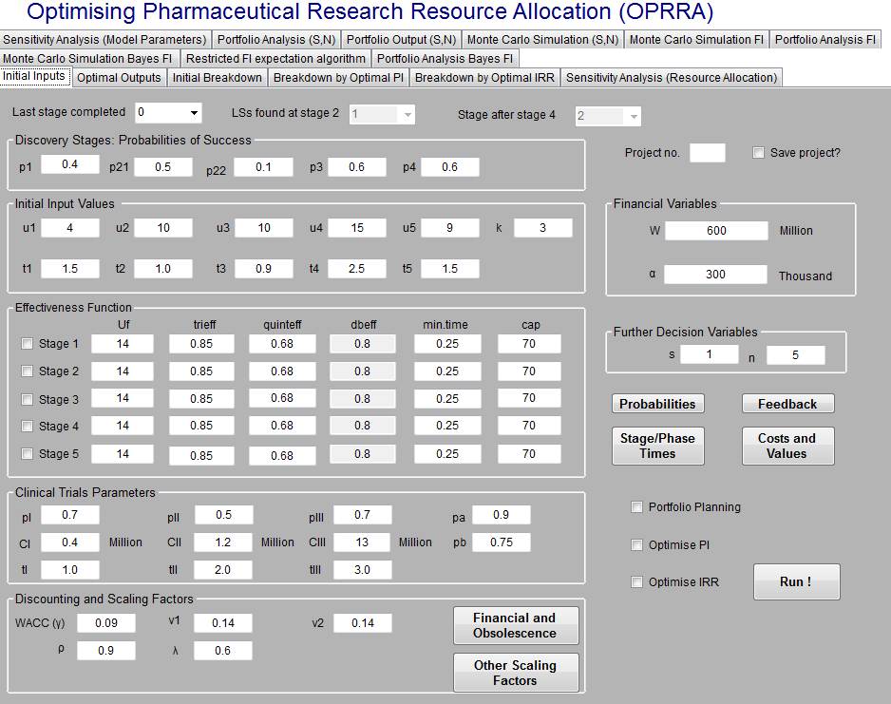

Slide 66
Use of Judgemental Probabilities for Estimation
For most of the model parameters the user can either enter values directly into the appropriate boxes, or do so with the help of a supplementary window which can be opened by clicking on the corresponding command box.

Slide 67
Obsolescence
In most cases the cash benefits resulting from the sales of a drug will themselves become lower if its launch time is delayed, due to the general tendency for better drugs to become available from competitors as time goes by. This effect is known as “obsolescence”.
In addition, when competitors learn of progress in our project, the intensity of their research and the similarities between the compounds screened by competitors and those screened in our project may both increase. This effect we will call “self-induced obsolescence”.

Slide 68
Discount Rates
γ : discount rate for money in real terms (eg 0.05)
This means that the value of £1 will become £e ^{γt} after t years.
ν₁ : obsolescence rate for the reward from a CD in real terms, excluding self-induced obsolescence
(eg 0.2)
ν₂ : obsolescence rate for the reward from a CD in real terms, including self-induced obsolescence
(eg 0.4)
Notes:
Since the value of a sum of future money is lower than that of the same sum of money available immediately, the discount factor, gamma, will be applied to calculate the expected costs.
Gamma 1 is amount to gamma + obsolescence effect.

Slide 69
Discounting & Obsolescence
The command box ‘Financial and Obsolescence’ opens the window shown in the next slide, from which the discount rates ν₁ and ν₂ may be calculated.
Significant milestones in the progress of competitors are described as ‘Type 1 events’ and ‘Type 2 events’.
The parameters f_{i} are the fractions by which the value of an unmarketed new drug would be reduced by the occurrence of a type i competitive milestone Alternatively, ν₁ and ν₂ may be estimated and entered directly.

Slide 70
Profitability Criteria
OPRRA uses two alternative criteria as follows.
Profitability Index (PI) = E(R)/E(C),
where E(R) = expected discounted reward (or value), and E(C) = expected discounted cost.
E(R ) is calculated after subtraction of the expected costs of clinical trials and E(C) is expressed in terms of senior scientist years in discovery. This means that PI is the expected value generated per senior scientist year in discovery.
Internal Rate of Return (IRR). This is the value of the exponential discount rate γ for which the expected net present value E(R) - E(C) is equal to zero.

Slide 71
Why Might a Crash Allocation be a Good Idea?
Because
Rewards occur later than most costs.
The discount rate for R includes obsolescence.
So for two reasons R is discounted more than C; and
this discounting differential is minimised if the time taken to complete the project is minimised.
71

Slide 72
An Unrealistic Example
In this example: -
There is just one stage.
Crashing has no effect on efficiency.
R and C are both discounted at the same rate γ.
72

Slide 73
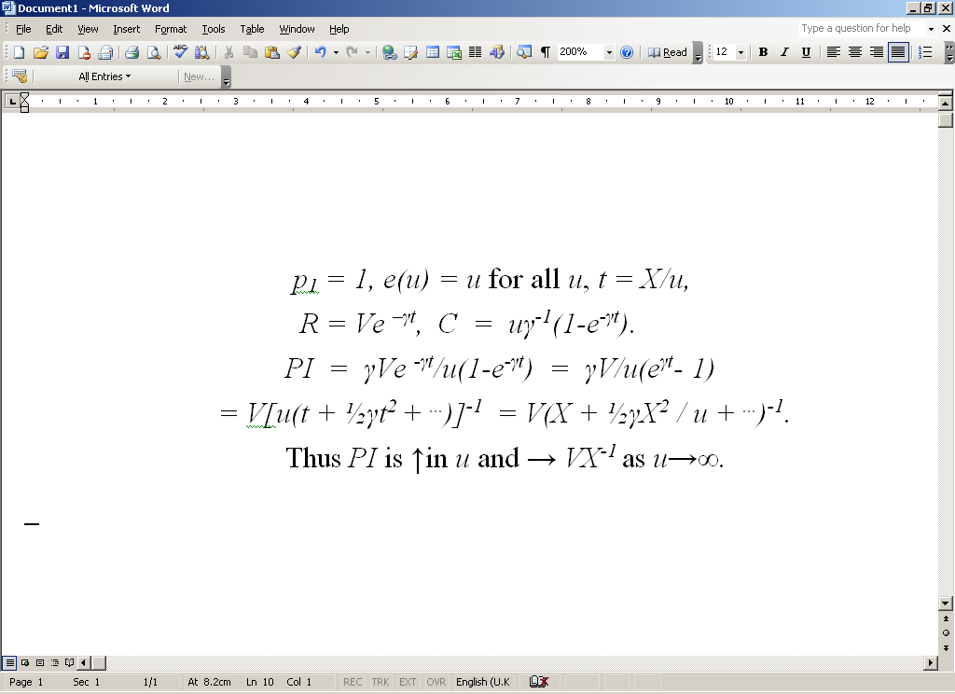

Slide 74
Conclusions
74
For Research Managers: A crash allocation might increase the profitability of potentially profitable projects.
For Analysts: Forwards Induction is a useful tool for resource allocation.

Slide 75
Capital Project Valuation taking account of Risk
First Candidate
Expectation and Variance of Net Present Value, discounting at the relevant Weighted Average Cost of Capital.
Var(NPV) and WACC are both measures of risk. However neither addresses the key issue of the possibility of a very bad outcome.

Slide 76
Two Candidates for doing this
Utilities
These in principle take account of the decision-maker’s attitude to risk, but have no in-built rules for dealing with different cash flows.
Value at Risk
The Value-at-Risk (VaR) is defined as a sum of money such that the probability of losing more than that amount takes some specified value. It thus does focus on bad outcomes, as required. However it focuses on a particular point in time, such as the endpoint of a project.

Slide 77
Two ways of improving on VaR
Consider the maximum indebtedness reached by the aggregate cash flow, rather than simply the NPV at the end of the project. Call this maximum the cash flow exposure, CFE.
As above, but now add to the aggregate cash flow at each stage the expected value of future cash flows, and consider the maximum indebtedness on this basis, taking into account future prospects. Call this maximum the prospective cash flow exposure, PCFE.

Slide 78
Properties of CFE and PCFE
Theorem 1. With discount rate γ = 0, (i) CFE ≥ - NPV, (ii) PCFE ≥ -NPV.
These results are immediate consequences of the fact that NPV = NRV(T) = ENPV(T). Here T = Completion time of project, NRV(t) = Aggregate net retrospective value at time t , and ENPV(t) = Expected net present value at time t, conditional on what happens up to time t.

Slide 79
Uncertainty Risk
The inequality PCFE ≥ -NPV holds with equality in the case of a deterministic sequence of costs and rewards, in which case NPV takes a unique predictable value.
Thus EPCFE + ENPV, with γ = 0, is a measure of the risk associated with uncertainty. Another such measure is Var(NPV).

Slide 80
A Simple Example
Project with two time points. Time 0, project starts. Time 1, project finishes. γ = 0, Var(NPV) = 1, ENPV = 0.
PCFE = - min[ENPV(0), ENPV(1)]
= - min[ENPV, NPV] = max[0, - NPV]. Write NPV = X and suppose P(X = m) = P(X = - m) = p, P(X = 0) = 1 – 2p, where m > 0. Thus EX = 0, VarX = 2pm² = 1, and EPCFE = pm = 1/2m, which takes all values in the interval (0, 0.5] as m varies between ∞ and 1.

Slide 81
Theorem 2.
For a random variable X∈R the maximum value of E(max[0,X]), subject to the constraints EX = 0 and VarX = 1, is 0.5, and occurs when P(X = 1) = P(X = - 1) = 0.5.

